Slide 1

Inside Sherpa – Digital Internship
Cloud Engineering overview Module

Slide 2
Understanding Cloud Computing
Defining Cloud Computing
Cloud computing is on-demand access, via the internet, to computing resources—applications, servers (physical servers and virtual servers), data storage, development tools, networking capabilities, and more—hosted at a remote data center managed by a cloud services provider (or CSP). The CSP makes these resources available for a monthly subscription fee or bills them according to usage.
Establishments of all kinds, sizes and industries manipulate the cloud for wide use ways such as data backup, disaster recovery, email, virtual desktops etc. Healthcare providers, for example, have been using the cloud to create more customized therapies for customers, and financial management firms are using the cloud to help monitor and deter theft in real time.

Slide 3
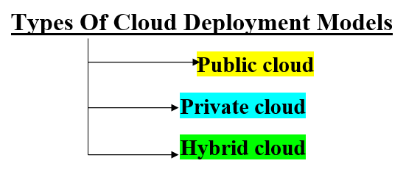
Understanding Cloud Computing
Cloud Characteristics
Characteristics of Cloud Computing:-
Resources Pooling
On-Demand Self-Service
Easy Maintenance
Scalability And Rapid Elasticity
Economical
Measured And Reporting Service
Security
Automation
Resiliency And Availability
Large Network Access
Public cloud- Any examples of the public cloud are the ones sold by Amazon , Microsoft or Google. These businesses offer both services and facilities which all customers share. Public clouds usually have huge amount of space available, turning into simple scalability.
Private Cloud- Personal clouds are typically placed behind a firewall and operated by a single organization. A fully on-premises cloud may be the recommended solution for companies with really tight regulatory standards, although demand is gaining with private clouds enforced through a colocation provider. Registered users can connect, use, and archive data from anywhere in the private cloud, just as they do in a public cloud.
Hybrid cloud- Hybrid clouds blend private clouds with the public clouds. They are designed to permit seamless interaction between the two platforms, with data and applications transferring smoothly from one to the other. The main benefit of a hybrid cloud paradigm is the potential to combine access and autonomy of a private cloud with the flexible processing capacity of a public cloud.

Slide 4
Understanding Cloud Computing
Cloud Capabilities
Cloud services allow universities to cost-effectively upgrade communication and learning systems without massive capital investments in infrastructure.
1. Strong virtual classroom environments
With cloud-based software, it becomes possible for educational organizations to have virtual classrooms for the students. The concept reduces the infrastructural costs to a considerable extent. They can even reduce the expenses of onboarding regular teachers in their faculty. Rather, they can collaborate with skilled trainers who work remotely and serve as cost-effective resources.
2. Moving Their Online Learning Platform to the Public Cloud
They support millions of users and thousands of schools, academic institutions, and corporations around the globe. In their highly competitive market, they stand out for their innovation, high availability, and quality.
3. Secure data storage
Besides accessibility and cost savings, cloud computing also serves the benefit of secure data storage. Organizations that deliver learning through the cloud can adopt a VPN for ensuring data security. VPN protocols such as IKEv2 are responsible for the automatic encryption of outgoing data and traffic. This means that the learning content can be easily transferred to the users without compromising its integrity. At the same time, learners can protect their privacy by using VPN for cloud-based learning applications.

Slide 5
Understanding Cloud Computing
Cloud Capabilities
4. Scalability
Cloud computing covers the schools, colleges, and universities on this front as well. It enables them to scale up the learning applications and experiences quickly and easily. As a result, they can handle an increasing number of students on events like training registrations and assignment submissions. Similarly, they can scale down instantly during the low activity period to prevent wastage of resources.
5. Support of Massive Open Online Courses (MOOCs), which first appeared on the higher education scene in 2012, with a modest worldwide enrollment of 1.5 million. By 2016, through leveraging cloud-based infrastructures, global MOOC enrollment figures had reached 58 million, with courses being offered by the world’s foremost universities such as Stanford, Harvard, and Columbia.

Slide 6
THANK YOU
Shefali Gosain
Deloitte Virtual Intern

